Slide 1

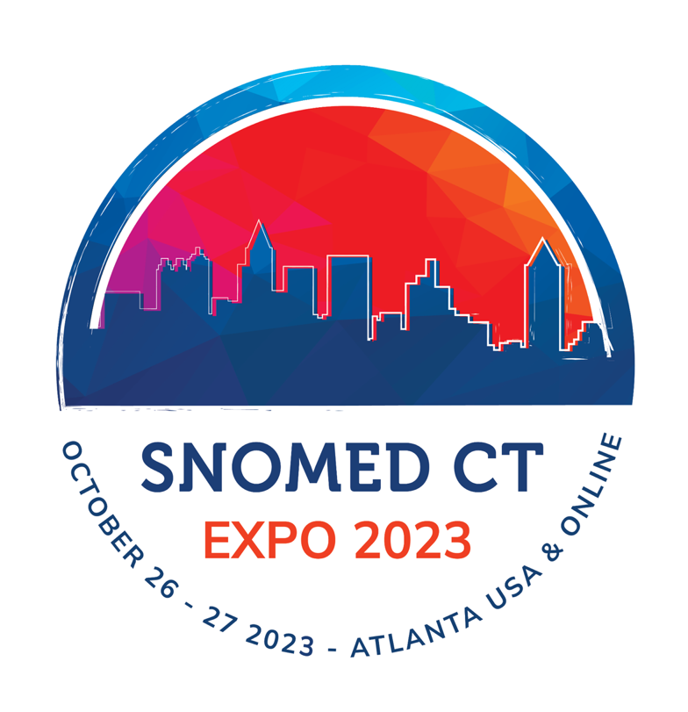
Interoperation and Analytics of EHR Data
James Campbell
Olivier Bodenreider
Robert Wynne
Stan Huff
W Scott Campbell
Global terminology enabling quality information exchange

Slide 2
Agenda
Introductions
Acknowledgements
Interoperation defined; relationship to SNOMED CT; Workshop Tooling: MRCM, ECL and OWL
SNOMED Clinical Findings and Interoperation use cases for Problem Lists
RxNorm Medicinal Products Interoperation for Research and Decision Support
LOINC Laboratory results Observables Interoperation for Analytics and Decision support
SNOMED Anatomic Pathology Observables Interoperation for Decision support and Cancer Research

Slide 3
Acknowledgements and Thank you is not enough
Robert Wynne is a research programmer for the Lister Hill Center of the National Library of Medicine and data analyst for RxNorm OWL and Nebraska Lexicon preparation
Jay Pedersen and Stefan Friesema are research software engineers working on Nebraska Public Health Lab and UNMC PCORnet datamart development
B2I staff led us through the details of implementing the NLM OWL database into RF2 datasets and fixed our mistakes
Rory Davidson and SNOMED International editorial have collaborated with the Regesntrief Institute to implement the LOINC extension and provide support for this workshop
Toni Morrison, Julie James and the Drug Model Working Group have guided the development of the international drug and substance concept model
Pathology and Laboratory Medicine CRG has spent long hours in developing content for Anatomic Pathology on behalf of the worldwide pathology informatics communities

Slide 4
Learning Objectives
Be able to define interoperability and how this relates to data re-use in a Learning Healthcare system
Understand the importance of an ontology as a computational tool for the management, manipulation and computation of clinical data and how the SNOMED CT-LOINC-MEDICATION concept model supports interoperability and analytics in healthcare and research
Appreciate the importance and utility of an integrated computable conceptualization for Clinical findings, Observable entities, Pharmaceutical and Biological products and understand how to employ that model for analytics use cases in clinical care, research and epidemiology
Identify and understand use cases for interoperation of electronic health record (EHR) data

Slide 5
Resources for this workshop
ZOOM:
Handout References: https://github.com/UNMC-CRANE/SNOMED_CT_Workshop_Nov_2023
Expression Constraint Language-v50
SNOMED CT Editorial Guide-v4-20230928
International Medicinal Product model
PCORnet common data model_v61
RxNorm-in-OWL
Computable Phenotypes ECL Exercises_20231025.docx
https://Browser.ihtsdotools.org/?
https://dev-nebraska-browser.ihtsdotools.org/

Slide 6
Interoperability
“Semantic interoperability is the ability of computer systems to exchange data with unambiguous, shared (therefore computable) meaning. Semantic interoperability is a requirement to enable machine computable logic, inferencing, knowledge discovery, and data federation between information systems.”
-Wikipedia
In healthcare, interoperability is key to achieving the vision of the Learning Health System proposed by the Institute of Medicine and taken up by several SNOMED member countries. That was one stimulus for the modern EHR

Slide 7
Why is interoperability important?
In decision support for clinical healthcare, universal sharing of data definitions and structures supports transportability and reproducibility of knowledge tools
In pragmatic research the ability to reliably and reproducibly retrieve EHR data across the breadth of the healthcare industry requires standardization of data definitions
In public health, optimization and equity in healthcare for all society requires universal access and appreciation of healthcare process and outcomes

Slide 8
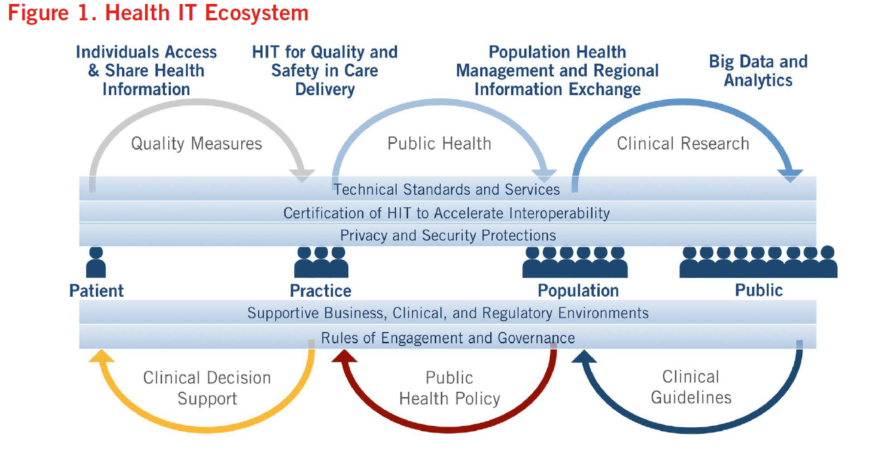
ONCHIT Vision for Learning Health System

Slide 9
Interoperation of EHR Information
Information model (top level ontology)
Vocabulary model (domain ontology): Terminology, Relationships, Descriptions
Data representation model
Interface (entrance) terminology and methods
The complete, unambiguous and consistent binding of these
three standards-based elements among a community of
users of (EHR) data employing shared query standards supports semantic interoperation

Slide 10
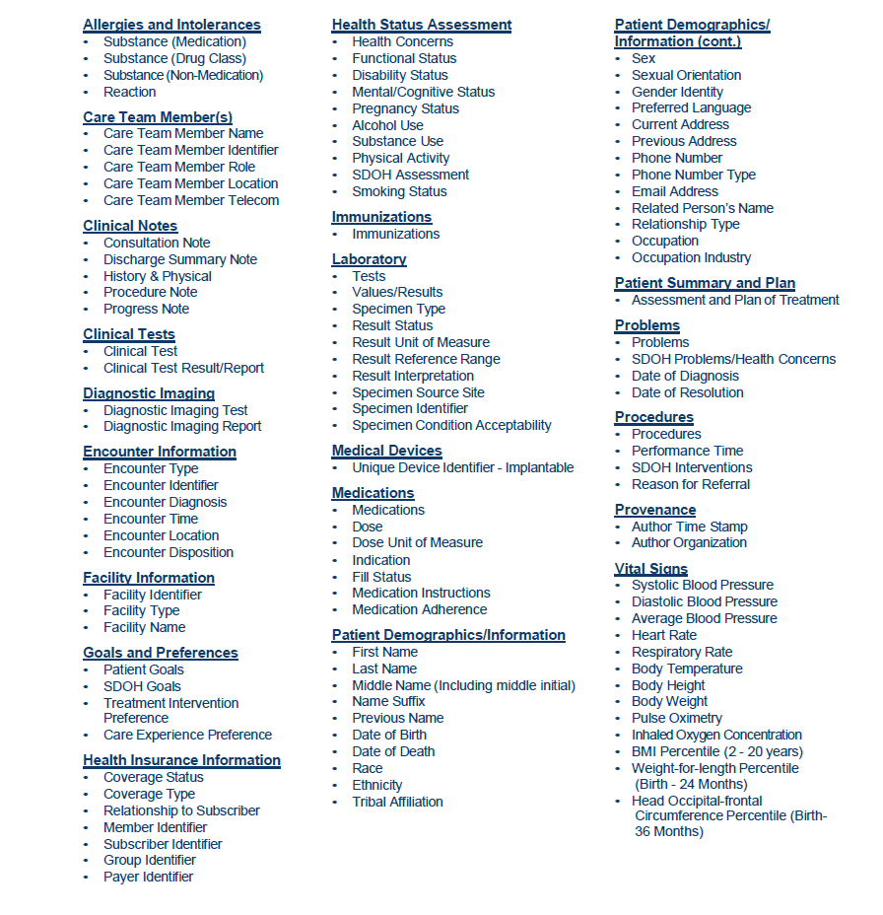
ONCHIT Vision for Interoperation: USCDI Top level ontology
Is evolving from public dialogue and policy revisions originating with the HHS/NLM terminology discussion mandated by HIPAA
Identifies top-level classes for EHR
Specifies bindings to ontology/terminology standards for US EHR interoperation
Use of the USCDI standard is required as part of the new application programming interface (API) certification criterion, “standardized API for patient and population services” (§ 170.315(g)(10))
Version 4 included in handout material

Slide 11
NCVHS Clinical Vocabulary Resources 2002
Ontologies
Foundational model of anatomy, Gene ontology, NCBI
Reference terminologies
SNOMED CT
LOINC
RxNorm
Multum, FDB
Nomenclatures; Controlled Terminologies
MESH, UMDNS, MedDRA, NDC, UCUM, UDI, NDC, CDC, CVX, IETF
NANDA, NIC, NOC, HHC, Omaha
Classifications (HIPAA Transaction Codesets)
ICD-10-CM, ICD-10-PCS, ICFDH
CPT-4, HCPCS, CDT
Metathesaurus: UMLS, NCI metathesaurus
Ontology: a computable conceptualization
Reference terminology: semantic network of meaning
Classification: monohierarchical network of exclusive classes
Controlled Terminology: term lists with tokens
Metathesaurus: semantic network of vocabulary resources

Slide 12
US Core Data for Interoperability v4 Vocabulary Standards 2024
Ontologies
Foundational model of anatomy, Gene ontology, NCBI
SNOMED CT
Reference terminologies
LOINC
RxNorm
Multum, FDB
Nomenclatures; Controlled Terminologies
MESH, UMDNS, MedDRA, NDC, UCUM, UDI, NDC, CDC, CVX, IETF
NANDA, NIC, NOC, HHC, Omaha
Classifications (HIPAA Transaction Codesets)
ICD-10-CM, ICD-10-PCS, ICFDH
CPT-4, HCPCS, CDT
Metathesaurus: UMLS, NCI metathesaurus

Slide 13
US Core Data for Interoperability v4 Vocabulary Standards 2024
Integrated Domain ontologies
SNOMED CT
LOINC
RxNorm
HIPAA Transaction Codesets
ICD-10-CM, ICD-10-PCS, ICD-11
CPT-4, HCPCS, CDT
Hypothesis: An integrated set of Domain Ontologies for Health System
datasets employing shared elements and relationships promotes
interoperability and advances the progress of the Learning Health System

Slide 14
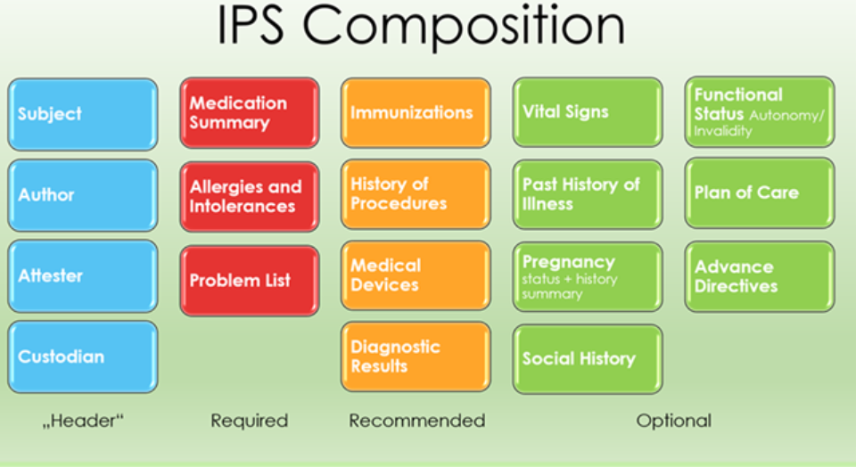
Interoperation of EHR Information ECL: ^816080008|International Patient Summary|
Information model: Global Digital Health Partnership(https:\\gdhp.health) - International Patient Summary
Vocabulary model: FHIR, (C)CDA vocabulary bindings
Data representation model

Slide 15
Nebraska Lexicon SNOMED Extension https://dev-nebraska-browser.ihtsdotools.org https://nelexicon.unmc.edu
Pending publication of LOINC laboratory extension by Regenstrief, we will use Nebraska namespace for the workshop
Components:
SNOMED International edition 20230630
911754091000004101| Nebraska LOINC Laboratory module I
443651000004109|Nebraska NLM RxNorm Medication module |
911754081000004104|Nebraska Pathology Synoptic module |
32640001000004108|Nebraska Clinical extension module |

Slide 16
SNOMED Concept Model Tooling for Semantic Interoperability
Early experiments with post-coordination identified need for logical grammatical constraints in the use of defining attributes and valuesets
2009 - Machine Readable Concept Model
Editorial guide: MRCM documentation:confluence.ihtsdotools.org/display/DOCEG/
MRCM documents and standardizes SNOMED concept model in promotion of interoperability: confluence.ihtsdotools.org/display/DOCMRCM/
PDF in handouts: Clinical findings (pp 161ff), Substances (pp 503ff), Pharmaceutical and biological products (pp 283ff), Observable entities (pp 248ff)
Provides a framework for designing and implementing tooling for interoperable URU analytics

Slide 17
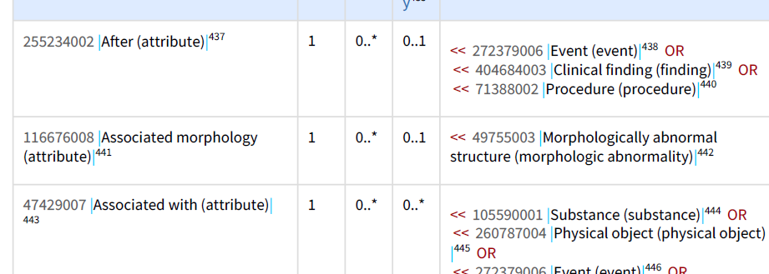
SNOMED Tooling: Expression Constraint Language
PDF for version 5 ECL documentation included with handouts:
Expression Constraint Language - Specification and Guide-v50-20231001
Expression Constraint Language: formalisms for computable query and manipulation of SNOMED CT metadata such as:
* Terminology binding
* Intensional reference sets (valuesets)
* Computable Phenotype SNOMED content queries of EHR databases use valuesets
* Specifications for SNOMED CT MRCM

Slide 18
EHR Interoperability Re-Use Cases
Clinical and Healthcare Enterprise
Enterprise business management
Clinical decision support
Healthcare process improvement
Research
Adverse event monitoring and safety: FDA Sentinel
Clinical data research networks: PCORnet, OHDSI, N3C
Patient-powered research networks
Public and Population Health
Morbidity and Mortality monitoring

Slide 19
Interoperation of Problem List for Clinical Research James Campbell

Slide 20
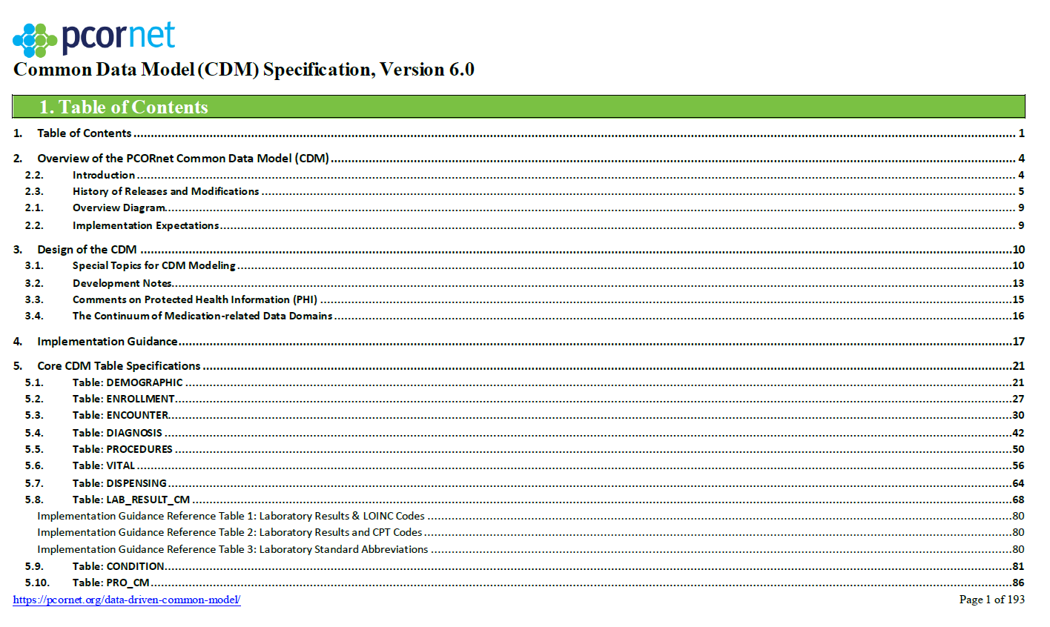
Clinical Data Research Networks Interoperation
Dozens of CDRNs in the US since Y2K & MU
Nebraska participates in PCORnet, OHDSI/OMOP➔N3C
Strict governance model managing sharing of limited data sets across 100+ datamarts
Top level ontology == Common Data Model v6; relational table data specifications following data classes of SENTINEL/HL7/USCDI; employing USCDI terminologies
CONDITION table stores problem list, past history and RFV; SNOMED CT Clinical findings is domain ontology
Datamarts are managed by owners; PCORnet distributes data queries (SAS) for approved research projects to all participating sites

Slide 21
ADAPTABLE© Pragmatic Trial
Hypothesis: The optimal dosage of aspirin (81 or 325 mg) for secondary prevention of heart disease outcomes has the best benefit/side effect ratio
Design: Randomized dosing cohort observational trial
Inclusion criteria: Documented atherosclerotic coronary disease with one or more coronary risk factors
Exclusion criteria: Adults, aspirin allergy, pregnant, nursing mother, recent GI bleeding, hemorrhagic disorder, requires anticoagulant therapy
Intervention: Randomized to 81mg or 325 mg aspirin
Outcomes: Mortality, heart attack or stroke
Safety endpoint: Major bleeding complication
Schuyler-Jones et all. Comparative Effectiveness of Aspirin Dosing in Cardiovascular Disease. NEJM; May 15, 2021. DOI: 10.1056/NEJMoa2102137

Slide 22
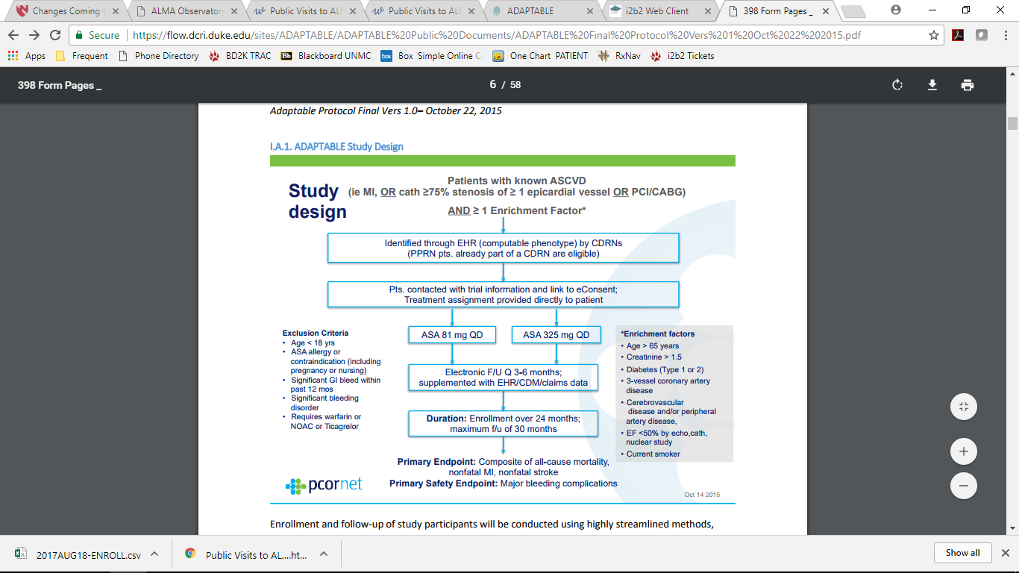
Analyzing Data Management for ADAPTABLE Trial Recruitment Criteria
Computable
Notes:
Jim

Slide 23
Computable Phenotypes and LHS
A Computable phenotype refers to a set of clinical data that can be evaluated via a standardized computerized query to an EHR or clinical data research network”
Richesson RL, Smerek MM, Cameron CB. A Framework to Support the Sharing and Reuse of Computable Phenotype Definitions Across Health Care Delivery and Clinical Research Applications. eGEMs: 2016; Vol. 4: Issue 3, Article 2.
A requirement for reproducible, accurate and valid scientific network research in healthcare
Notes:
Thinking about the way that EHR data is re-used for research in a CDRN such as PCORnet, we realize that standards for network communication and data query must be part of the framework. Data communication in PCORnet occurs via web services. The data queries for retrieving facts needed to answer the research question must be unambiguously and reproducibly defined by the study protocol. Those queries are called computable phenotypes. In the paper I have mentioned, RR proposes a national standardization of those queries.

Slide 24
Pragmatics of developing computable phenotype
Semantic analysis 1: Translate language of the request into the (USCDI/PCORnet) top level data classes(tables) for query of the database
Identify the components (attributes or columns) of the class that are essential to the request and determine the relevant domain ontologies that are required (for Nominal datatypes)
Semantic analysis 2: For nominal data identify the relevant elements (codes) of the domain ontology that are required by the query; this is typically referred to as a “Valueset”
Construct the query defining the computable phenotype

Slide 25
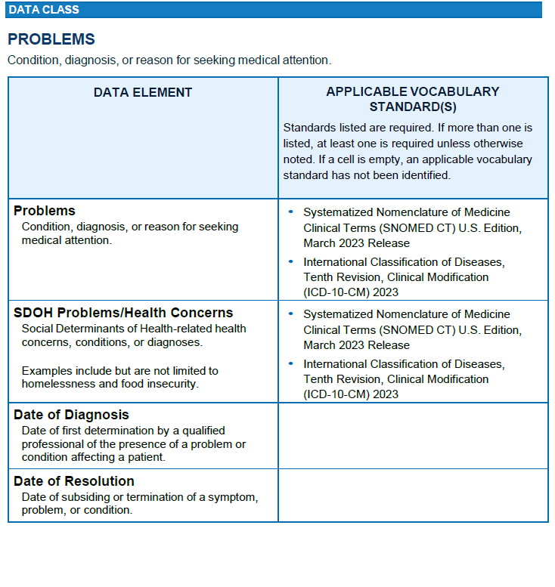
Interoperable Valuesets for ADAPTABLE
“Patients with ASCVD
(Arteriosclerotic Coronary Vascular Disease)”
??? ➔ CONDITION TABLE: CONDITION = “ASCVD”, CONDITION_STATUS = “Active”; CONDITION_STATUS = “Healthcare Problem List”
What are the appropriate codes for “Arteriosclerotic coronary vascular disease”?
Search of keywords and code names in ICD-10-CM publication from CDC leads to I25.**
??? ➔ CONDITION TABLE: CONDITION LIKE ‘I25%’, CONDITION_STATUS = “Active”; CONDITION_STATUS = “Healthcare Problem List”

Slide 26
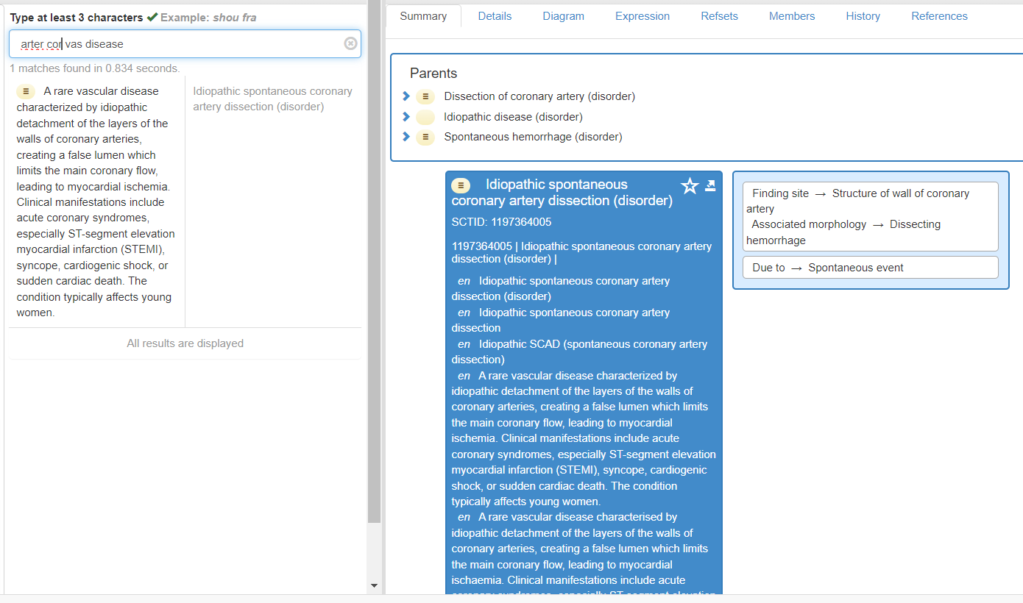
Interoperable Intensional Valuesets for ADAPTABLE
“Patients with ASCVD”
??? ➔ CONDITION TABLE: CONDITION = “ASCVD”, CONDITION_STATUS = “Active”; CONDITION_STATUS = “Healthcare Problem List”
What are the allowable SNOMED CT codes for Arteriosclerotic Coronary Vascular Disease?

Slide 27
Interoperable Intensional Valuesets for ADAPTABLE
“Patients with ASCVD”
??? ➔ CONDITION TABLE: CONDITION = “ASCVD”, CONDITION_STATUS = “Active”; CONDITION_STATUS = “Healthcare Problem List”
What are the SNOMED CT codes for “Arteriosclerotic coronary vascular disease”?
??? ➔ CONDITION TABLE: CONDITION IN
( << 64572001 |Disease (disorder)| : << 363698007 |Finding site (attribute)| = << 41801008 |Coronary artery structure (body structure)|, << 116676008 |Associated morphology (attribute)| = << 28960008 |Arteriosclerosis (morphologic abnormality)|),
CONDITION_STATUS = “AC”; CONDITION_STATUS = “HC”
“37 concepts”
Why bother?
US Datamarts have varying editions of SNOMED CT installed; historically complete code systems are a requirement; reproducible computable phenotypes are a challenge

Slide 28
Interoperable Intensional Valuesets for ADAPTABLE
Myocardial Infarction???
Cerebrovascular disease???
Peripheral vascular disease???
Coronary artery bypass graft???
Coronary angioplasty???

Slide 29
Use Cases: Computable Phenotypes
Alcoholism: Bailey KL, Sayles H, Campbell JR,Khalid N, Anglim M, Ponce J, Wyatt T, McClay J, Burnham EL, Anzalone A, Hanson C. COVID-19 patients with documented alcohol use disorder of alcohol-related complications are more likely to be hospitalized and have higher all-cause mortality. Alcoholism Clin Exp Research 2022 Apr; 1:1-13.
Coronary disease: Schuyler-Jones et all. Comparative Effectiveness of Aspirin Dosing in Cardiovascular Disease. NEJM; May 15, 2021. DOI: 10.1056/NEJMoa2102137
Colorectal cancer: Carnahan RM, Waitman LR, Charlton ME, Schroeder MC, Bossler AD, Campbell WS, Campbell JR, McDowell BD, Smith NC, Gryzlak BM, Chrischilles EA. Exploration of PCORnet data resources for assessing use of molecular-guided cancer treatment. JCO Clin Cancer Inform 2020 Aug;4:724-735.
Hypothesis: Patients with advanced colorectal carcinoma residing in rural areas are less likely to be treated with molecular cancer therapies than those in urban areas.
Inclusion criteria: Adult patients (age > 18 years) with metastatic colorectal cancer
Independent variables: Gender, race and ethnicity, chemotherapy, molecular-guided therapies
Outcomes: N/A

Slide 30
Use Cases: Computable Phenotypes
CAUSATIVE AGENT
Alcohol use disorder:
Streptococcal diseases???
AND/OR/MINUS; AFTER; DURING
Colorectal Carcinoma
Coronavirus disease or complications???
Complications of eye surgery???

Slide 31
Use Cases: Computable Phenotypes
AlcohoL use disorder: Bailey KL, Sayles H, Campbell JR,Khalid N, Anglim M, Ponce J, Wyatt T, McClay J, Burnham EL, Anzalone A, Hanson C. COVID-19 patients with documented alcohol use disorder of alcohol-related complications are more likely to be hospitalized and have higher all-cause mortality. Alcoholism Clin Exp Research 2022 Apr; 1:1-13.
Coronary disease: Schuyler-Jones et all. Comparative Effectiveness of Aspirin Dosing in Cardiovascular Disease. NEJM; May 15, 2021. DOI: 10.1056/NEJMoa2102137
Colon cancer: Carnahan RM, Waitman LR, Charlton ME, Schroeder MC, Bossler AD, Campbell WS, Campbell JR, McDowell BD, Smith NC, Gryzlak BM, Chrischilles EA. Exploration of PCORnet data resources for assessing use of molecular-guided cancer treatment. JCO Clin Cancer Inform 2020 Aug;4:724-735.
Hypothesis: Adult patients with Alcohol use disorders that are infected with COVID-19 are more likely die from their illness.
Inclusion criteria: Adult patients (age > 18 years) with history of alcohol use disorder
Independent variables: Gender, race and ethnicity, comorbidities
Outcomes: Survival from onset of infection with COVID-19

Slide 32
Use Cases: Computable Phenotypes
AND/OR/MINUS; AFTER; DURING
Colorectal Carcinoma
Coronavirus disease or complications???
Complications of eye surgery???
PATHOLOGICAL PROCESS
Types of pathology: < 64572001 |Disease (disorder)| . 370135005 |Pathological process (attribute)|
Infections??? (7974 Clinical findings)
Parasitic infection/Infestation??? (1337 Diseases)

Slide 33
RxNorm Medicinal Products Interoperation for Research and Decision Support Olivier Bodenreider, Robert Wynne

Slide 34
Outline
SNOMED CT International Medicinal Product Model
RxNorm drug model vs. SNOMED CT’s
Converting RxNorm clinical drugs to the SNOMED CT model
Querying RxNorm and SNOMED CT drugs

Slide 35

ICBO 2018
Corvallis, Oregon August 8, 2018
The New SNOMED CT International Medicinal Product Model
Olivier Bodenreider and Julie James
Lister Hill National Center for Biomedical Communications Bethesda, Maryland - USA
Bodenreider O, James J. The new SNOMED CT international medicinal product model. Proceedings of the 7th International Conference on Biomedical Ontology (ICBO 2018) 2018: (electronic proceedings: http://ceur-ws.org/Vol-2285/ICBO_2018_paper_36.pdf).

Slide 36
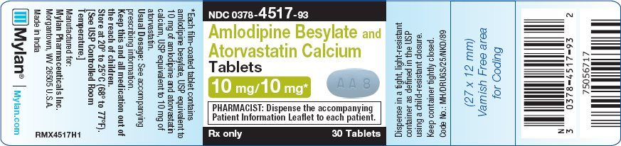

Slide 37
Medicinal products in SNOMED CT
Medicinal products vs. substances
MPs have substances as ingredients
Types of medicinal products
Ingredient + dose form + strength
Ingredient + dose form
Ingredient
Drug classes
Limited scope
No packaging or brand information
International Medicinal Product Model https://confluence.ihtsdotools.org/display/DOCMPM/SNOMED+CT+Medicinal+Product+Model+Specification

Slide 38
Use cases
To facilitate international interoperability of medication concepts
e.g., for use in patient summaries and for cross-border care
To provide a strong foundation for member countries to develop their national medicinal product terminology
e.g., by adding package and branded product information
To support medication analytics for research purposes
To support the development of international medication decision support
e.g., allergy checking and duplicate therapy checking

Slide 39
Patterns for types of medicinal products
Clinical drug
Precise ingredient + dose form + strength
Medicinal product form
Ingredient + dose form
Medicinal product form “only”
Ingredient + dose form, with universal restrictions
Medicinal product
Ingredient
Medicinal product “only”
Ingredient, with universal restrictions
Medicinal product “only” [optional]
Precise ingredient, with universal restrictions

Slide 40
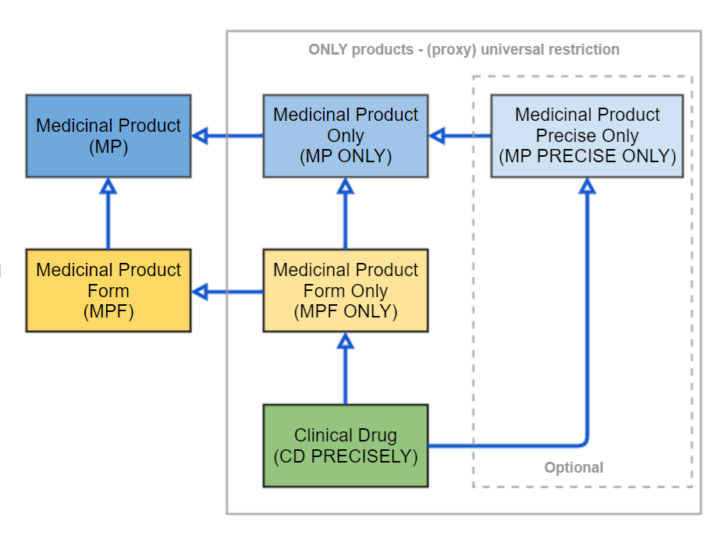

Slide 41
Open-world entities
Closed-world entities
Definitional features
Medicinal product (MP)
MP/MPO:
Active ingredient (substance)
409411009 | Product containing amlodipine and atorvastatin (medicinal product)
Medicinal product Only (MPO)
773457004 | Product containing only amlodipine and atorvastatin (medicinal product)
Medicinal product precise only (MPP)
MPP:
Precise active ingredient (substance)
Medicinal product
Form (MPF)
MPF/MPFO:
Active ingredient (substance)
Dose form (pharmaceutical dose form)
767867002 | Product containing amlodipine and atorvastatin in oral dose form (medicinal product form)
Medicinal product form only (MPFO)
CD:
Precise Active ingredient (substance)
Dose form (pharmaceutical dose form)
Basis of strength (substance)
Strength units (unit of measure)
Strength values (numbers)
Units of presentation (units of presentation)
773458009 | Product containing only amlodipine and atorvastatin in oral dose form (medicinal product form)
Clinical drug
IS-A
1153442009 | Product containing precisely amlodipine (as amlodipine besilate) 10 milligram and atorvastatin (as atorvastatin calcium) 10 milligram/1 each conventional release oral tablet (clinical drug) |

Slide 42
Pattern for Clinical Drug
Presentation strength
As opposed to normalized strength
To support the distinction among iso-concentration products
4 discrete elements
Numerator (value and unit), denominator (value and unit)
Basis of strength substance
Substance in reference to which strength is defined
Dose form and unit of presentation
Harmonized with international standards

Slide 43
Pattern for Clinical Drug
Closure axiom
Required to restrict a clinical drug to exactly its ingredients (only vs. some)
Should be implemented through universal restrictions
Has_ingredient SOME atorvastatin
Has_ingredient SOME amlodipine
Has_ingredient ONLY (atorvastatin OR amlodipine)
Universal restrictions not supported in EL++
Workaround: count of active ingredients
2 active ingredients

Slide 44
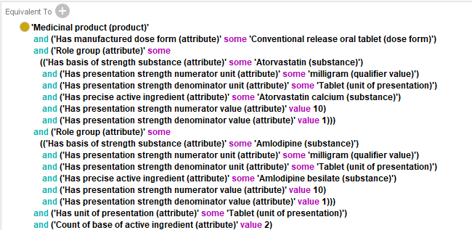
New SNOMED CT model
1153442009 | Product containing precisely amlodipine (as amlodipine besilate) 10 milligram and atorvastatin (as atorvastatin calcium) 10 milligram/1 each conventional release oral tablet (clinical drug) |

Slide 45
Drug classes (Groupers)
Based on disposition
Product containing 3-hydroxy-3-methylglutaryl-coenzyme A reductase inhibitor
Based on chemical structure
Product containing aminoglycoside
Based on intended site of administration
Product manufactured as parenteral dosage form
Based on therapeutic role
Conserved when intimately related to mechanism of action
Product containing antimalarial
Removed from the medicinal product hierarchy when purely regulatory information (non-definitional)
Antilipemic agent, Cardiovascular drug

Slide 46
Inference of product groupers from substance groupers
Groupers asserted in the substance hierarchy
Amlodipine (substance)
SubClassOf Substance with calcium channel blocker mechanism of action [substance grouper]
Groupers inferred in the product hierarchy
Product containing amlodipine (medicinal product)
SubClassOf Product containing calcium channel blocker [product grouper]
Has_ active_ingredient Substance with calcium channel blocker mechanism of action [substance grouper]

Slide 47
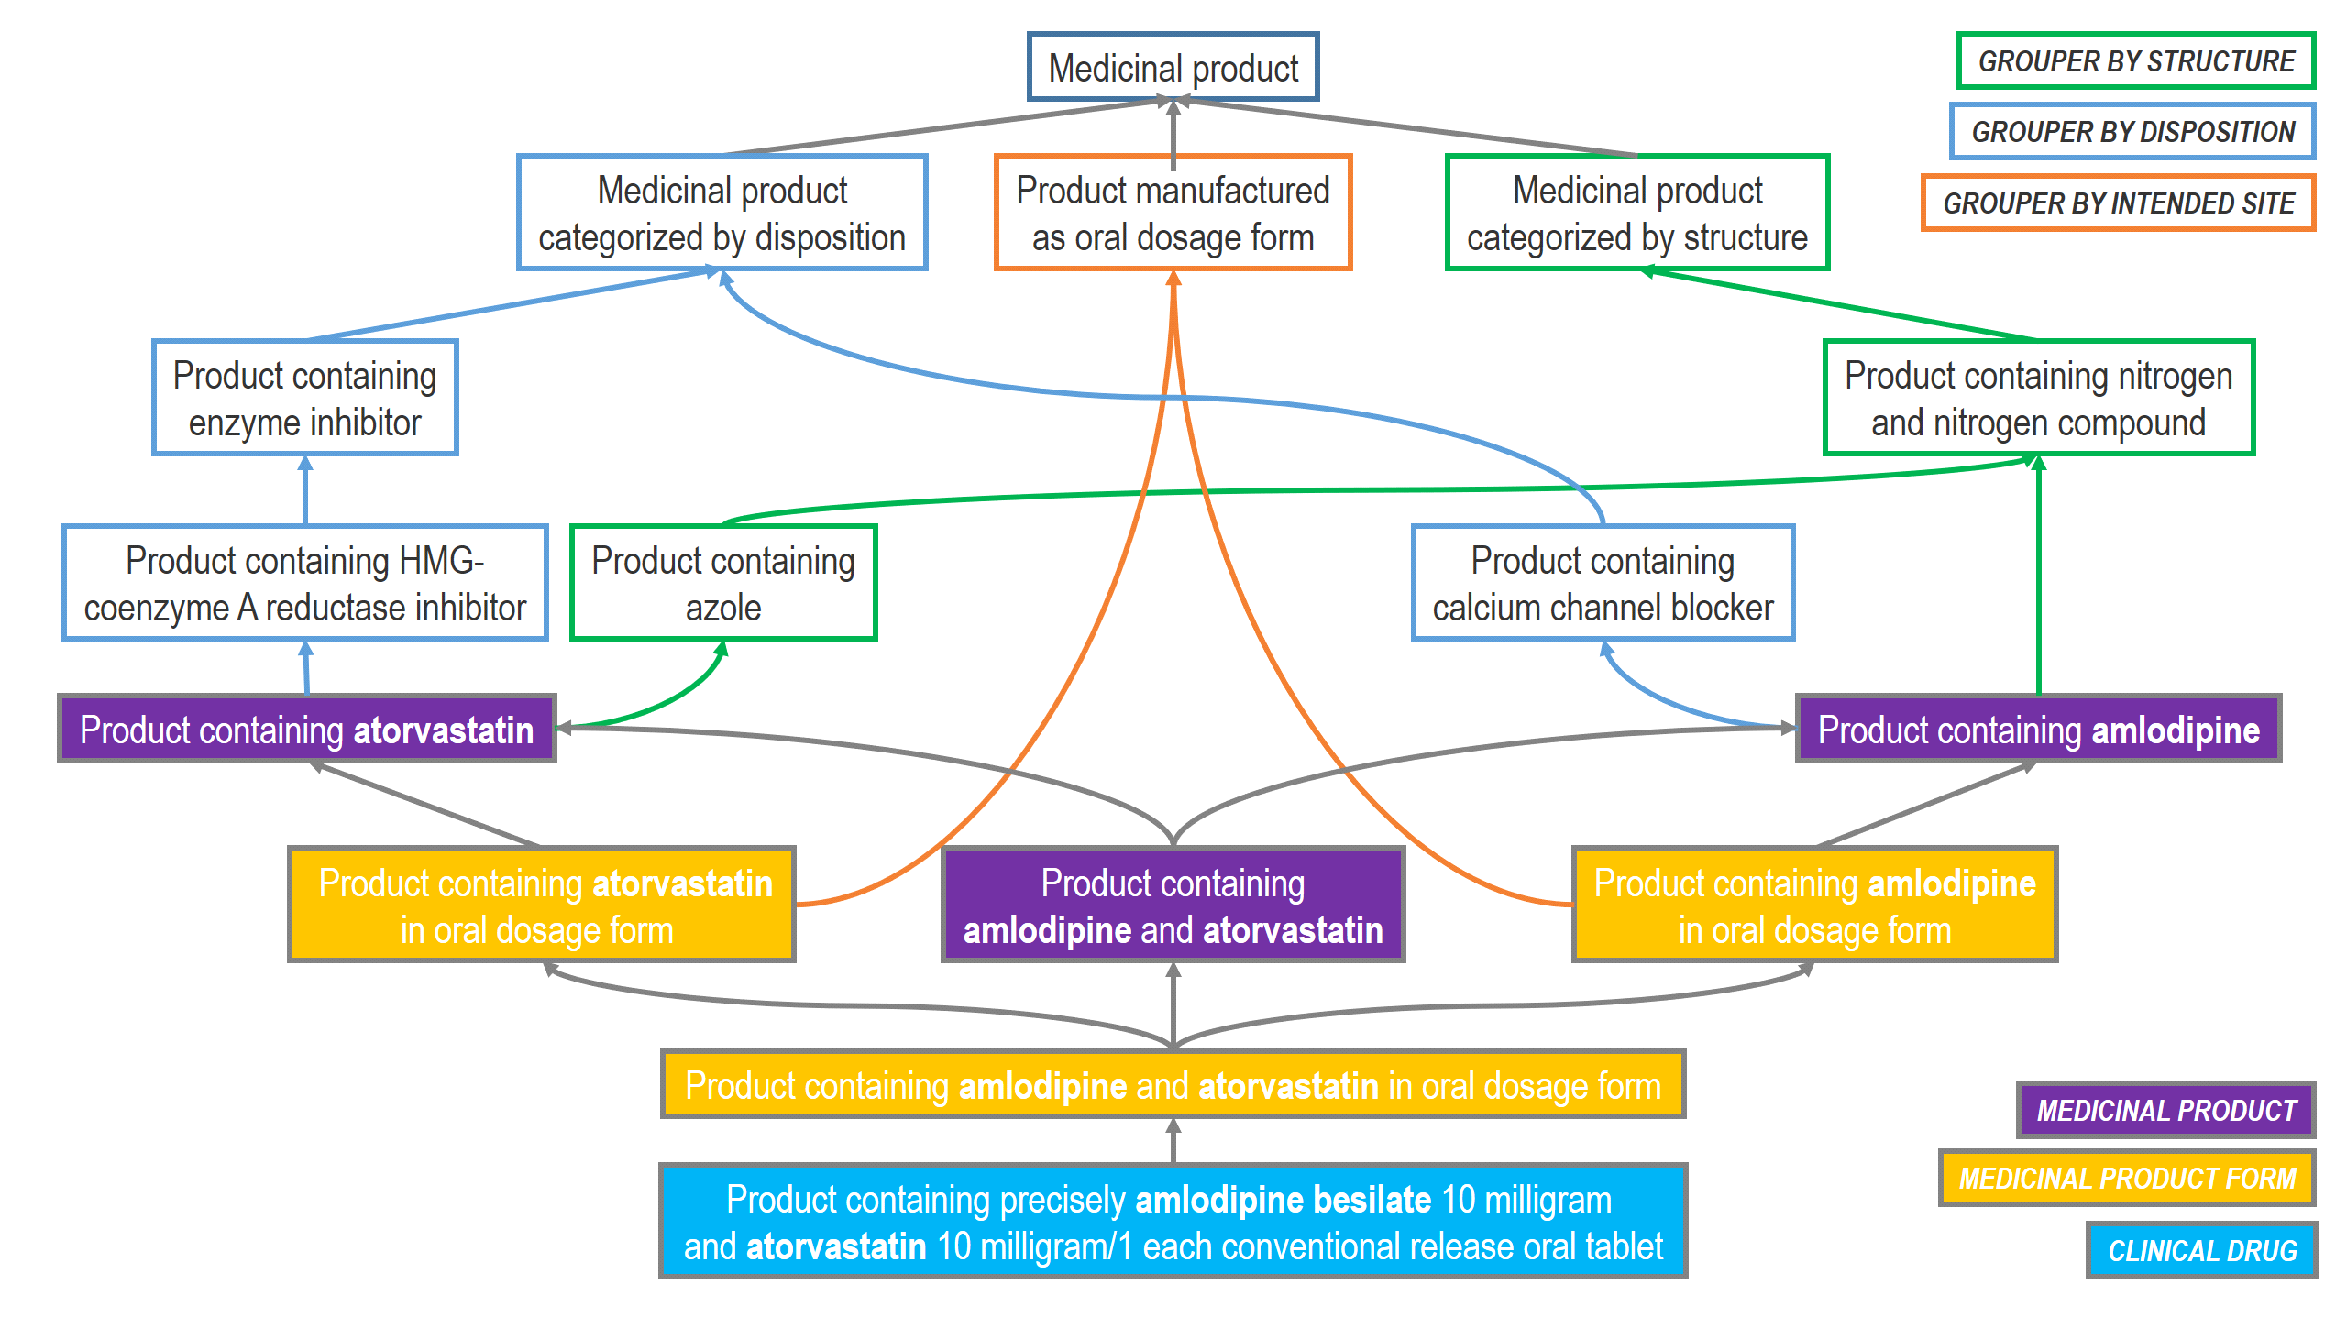
Medicinal product hierarchy (simplified*)
Product containing precisely amlodipine (as amlodipine besilate) 10 milligram and atorvastatin (as atorvastatin calcium) 10 milligram/1 each conventional release oral tablet (clinical drug)
* MP only and MPF only entities omitted

Slide 48
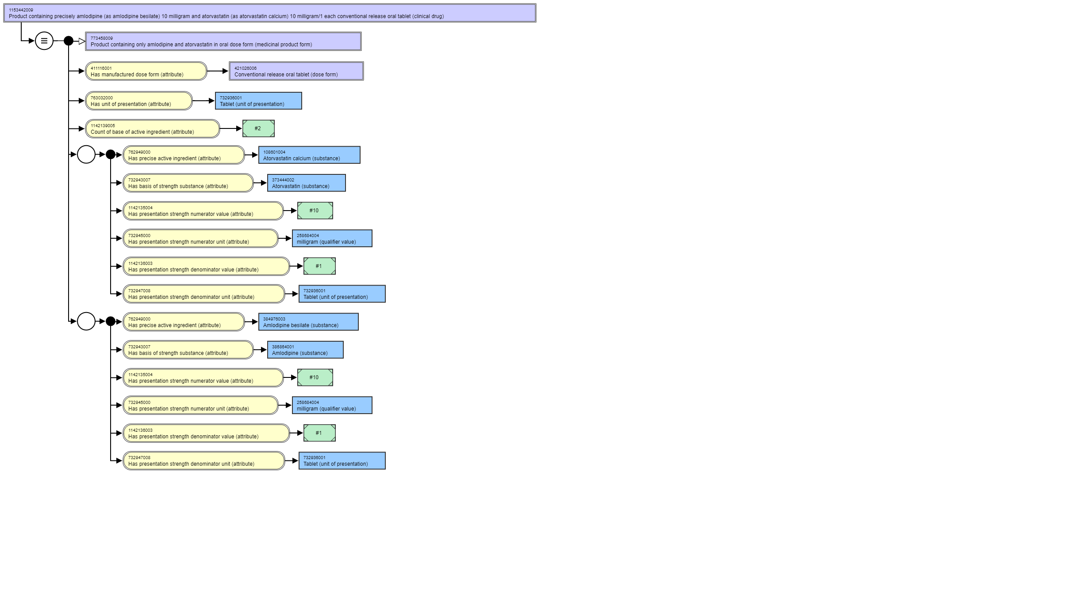

Slide 49
Discussion
Benefits
More comprehensive representation of medicinal products (MPs)
Necessary and sufficient classes for all MPs
MP hierarchy completely inferred
Support identification of equivalent clases
Interoperability with national extensions
Strong foundation for developing national extensions
Distinction among types of groupers
Compliance with international standards

Slide 50
Discussion
Limitations
Unorthodox closure axiom
Based on count of active ingredients
In the absence of universal restrictions in EL++
Partially implemented in the July 2018 release
Mostly oral solid dose form drugs
Ongoing work for oral solutions, parenteral drugs and topical drugs
Interoperability with national drug extensions not fully demonstrated yet
Ongoing work with RxNorm

Slide 51

Comparing the representation of medicinal products in RxNorm and SNOMED CT Consequences on interoperability
ICBO 2019
August 1, 2019
University at Buffalo
10th International Conference on Biomedical Ontology
Jean-Noël Nikiema & Olivier Bodenreider
National Institutes of Health, Bethesda, Maryland, USA
Nikiema J-N, Bodenreider O.
Comparing the representation of medicinal products in RxNorm and SNOMED CT – Consequences on interoperability.
Proceedings of the 10th International Conference on Biomedical Ontology (ICBO 2019): (electronic proceedings: http://ceur-ws.org/Vol-2931/ICBO_2019_paper_21.pdf)

Slide 52
Definitional features
RxNorm entities
SNOMED CT entities
SNOMED CT
RxNorm
Substance
IN/PIN (Substance)
Ingredient (IN)/
Precise ingredient (PIN)
IN/PIN (Medicinal product)
Medicinal product
Medicinal product only
Pharmaceutical
Dose Form
Dose Form (DF)
Clinical drug Form (SCDF)
Medicinal product
form
Unit of
presentation
Medicinal product form only
Unit of
measure
Strength Unit
Clinical drug (SCD)
Clinical drug
Number
Strength Value
Legend
Correspondence between definitional features
Definitional feature
Correspondence between entities

Slide 53
Findings: Consequences on interoperability
Can RxNorm be translated into SNOMED CT?
Yes, for the most part
Specifically
Ingredients
Trivial disambiguation
Strength
Different editorial conventions for units (minor)
Presentation strength / Concentration strength / Both (depending on unit of presentation)
Dose form – requires detailed analysis to identify dose form and unit of presentation

Slide 54
Conclusions
Similarities and differences between the representation of medicinal products in RxNorm and SNOMED CT
Both models share major definitional features including ingredient (or substance), strength and dose form
Subtle differences between the two models
Translation of RxNorm into SNOMED CT is possible, but not straightforward

Slide 55

14:00 Room: Hub 4
Lessons learned from instantiating the SNOMED CT international medicinal product model with RxNorm drugs products
Olivier Bodenreider
Robert Wynne
Global terminology enabling quality information exchange
Notes:
Where we will discuss the lessons learned from instantiating the SNOMED CT international medicinal product model with RxNorm drug products.

Slide 56
Creating DL definitions for RxNorm products
Create logical definitions in OWL for each RxNorm generic drug product based on the SNOMED CT model
[Adding branded products as children of the (generic) clinical drugs for convenience]
Classify these definitions using the OWL 2 EL Reasoner, ELK, together with the OWL version of SNOMED CT
ELK inferred logical equivalences between the RxNorm products and the corresponding products in SNOMED CT

Slide 57
Exploring medications (Browser)
Follow-along Activity
Tooling: SNOMED CT Browser (https://browser.ihtsdotools.org/)
International edition
RxNorm extension (experimental)
ECL (Expression Constraint Language) queries
Constraints on definitional and other features
Retrieval across SNOMED CT and RxNorm medications
Equivalent SNOMED CT and RxNorm medications shown as distinct classes

Slide 58
Q01 - ANTIBACTERIAL CLINICAL DRUGS AVAILABLE FOR ORAL USE
Constraints
Medicinal product [type]
Therapeutic role [Plays role]
Dose form [Has manufactured dose form]
ECL query
<< 763158003 |Medicinal product (product)| : << 766939001 |Plays role (attribute)| = << 787994008 |Antibacterial therapeutic role (role)|, << 411116001 |Has manufactured dose form (attribute)| = << 385268001 |Oral dose form (dose form)|
Results (2045 concepts)
Examples
Follow-along Activity

Slide 59
Q02 - ANTIBACTERIAL CLINICAL DRUGS AVAILABLE FOR SYSTEMIC ADMINISTRATION
Constraints
Medicinal product [type]
Therapeutic role [Plays role]
Dose form [Has manufactured dose form] ** multiple values
ECL query
<< 763158003 |Medicinal product (product)| : << 766939001 |Plays role (attribute)| = << 787994008 |Antibacterial therapeutic role (role)|, << 411116001 |Has manufactured dose form (attribute)| = (<< 385268001 |Oral dose form (dose form)| OR <<385287007|Parenteral dose form|)
Results (2970 concepts)
Examples
Follow-along Activity

Slide 60
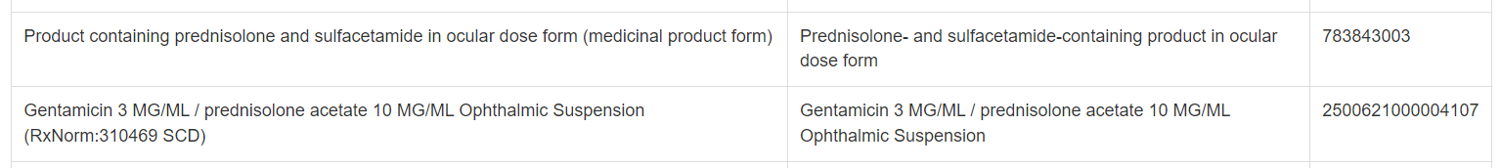
Q03 - ANTIBACTERIAL EYE DROPS
Constraints
Medicinal product [type]
Therapeutic role [Plays role]
Dose form [Has manufactured dose form]
ECL query
<< 763158003 |Medicinal product (product)| : << 766939001 |Plays role (attribute)| = << 787994008 |Antibacterial therapeutic role (role)|, << 411116001 |Has manufactured dose form (attribute)| = <<385276004 |Ocular dose form (dose form)|
Results (355 concepts)
Examples ** not limited to clinical drugs
Follow-along Activity

Slide 61
Q04 - EYE DROPS FOR GLAUCOMA
Constraints
Medicinal product [type]
Therapeutic role [Plays role]
Dose form [Has manufactured dose form]
ECL query
<< 763158003 |Medicinal product (product)| : << 766939001 |Plays role (attribute)| = << 773832000 |Antiglaucoma therapeutic role (role)|, << 411116001 |Has manufactured dose form (attribute)| = << 385276004 |Ocular dose form (dose form)|
Results (402 concepts)
Examples ** not limited to clinical drugs
Follow-along Activity

Slide 62
Q05 - WHAT MEDICATIONS DO I HAVE TO TREAT GLAUCOMA?
Constraints
Medicinal product [type]
Therapeutic role [Plays role]
** no constraints on Dose form
ECL query
<< 763158003 |Medicinal product (product)| : << 766939001 |Plays role (attribute)| = << 773832000 | Antiglaucoma therapeutic role (role) |
Results (464 concepts)
Examples ** include preparations other than eye drops
Follow-along Activity

Slide 63
Q06 - LISINOPRIL (BLOOD PRESSURE PILL) ORAL FORMULATIONS 5 MG AND STRONGER
Constraints
Medicinal product [type]
Ingredient [Has precise active ingredient]
Strength [Has numerator value, Has presentation strength numerator unit]
Single-ingredient formulation [Count of base of active ingredients]
ECL query
<< 763158003 |Medicinal product (product)| : << 762949000 |Has precise active ingredient (attribute)| = << 386873009 |Lisinopril (substance)|, 1142135004|Has numerator value| >= #5, << 732945000 |Has presentation strength numerator unit (attribute)| = 258684004 |milligram (qualifier value)|,
1142139005|Count of base of active ingredients| = #1
Results (22 concepts)
Examples
Follow-along Activity

Slide 64
Q07 - ALL ACTIVE INGREDIENTS IN AVAILABLE ANTICONVULSANT MEDICATIONS
Constraints
Medicinal product categorized by therapeutic role
Active ingredient [Has active ingredient]
. operator
ECL query
< 63094006 |Medicinal product acting as anticonvulsant agent (product)| . 127489000 |Has active ingredient (attribute)|
Results (48 concepts)
Examples ** returns substances, not clinical drugs
Follow-along Activity

Slide 65
Q08 - ANTIBACTERIAL CLINICAL DRUGS AVAILABLE FOR ORAL USE BUT ALLERGY TO SULFA DRUGS
Constraints
Medicinal product [type]
Therapeutic role [Plays role]
Dose form [Has manufactured dose form]
MINUS operator
Active ingredient [Has active ingredient]
ECL query
(<< 763158003 |Medicinal product (product)| : << 766939001 |Plays role (attribute)| = << 787994008 |Antibacterial therapeutic role (role)|, << 411116001 |Has manufactured dose form (attribute)| = << 385268001 |Oral dose form (dose form)|) MINUS (<< 763158003 |Medicinal product (product)| : 762949000 | Has precise active ingredient (attribute)| = << 372788003 |Substance with sulfonamide structure and antibacterial mechanism of action (substance)|)
Results (1905 concepts)
Examples of excluded medications
Follow-along Activity

Slide 66
Interoperation of Laboratory Data for Standardization, Research and Decision Support Stanley Huff

Slide 67
Why do we need clinical decision support?

Slide 68
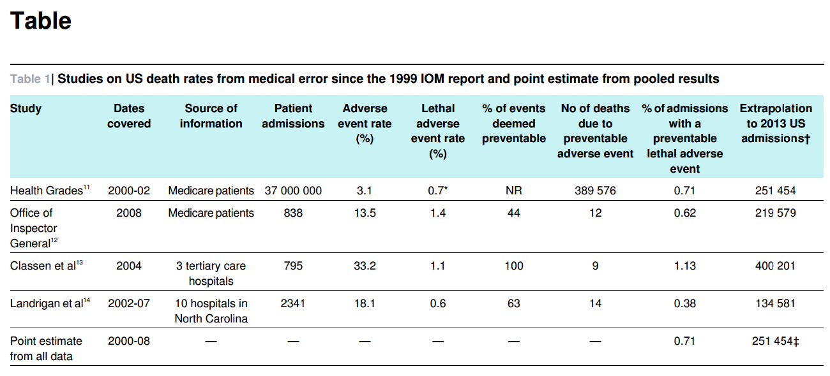
Medical Error – Third Leading Cause of Death in the US
BMJ 2016; 353:i2139 (Published 3 May 2016)
Physicians Do the Right Thing ~50% of the Time McGlynn EA, Asch SM, Adams J, Keesey J, Hicks J, DeCristofaro A, Kerr EA. N Engl J Med. 2003 Jun 26;348(26):2635-45.

Slide 69
Core Assumptions
‘The complexity of modern medicine exceeds the inherent limitations of the unaided human mind.’
~ David M. Eddy, MD, Ph.D.
‘... man is not perfectible. There are limits to man’s capabilities as an information processor that assure the occurrence of random errors in his activities.’
~ Clement J. McDonald, MD
16

Slide 70
Decision Support Modules (Intermountain)
Antibiotic Assistant
Ventilator weaning
ARDS protocols
Nosocomial infection monitoring
MRSA monitoring and control
Prevention of Deep Venous Thrombosis
Infectious disease reporting to public health
Diabetic care
Pre-op antibiotics
ICU glucose protocols
Ventilator disconnect
Infusion pump errors
Lab alerts
Blood ordering
Order sets
Patient worksheets
Post MI discharge meds
All of these applications decrease cost and improve health!

Slide 71
So what is one answer to better care?
Clinical Decision Support!
But …
MedInfo 17th World Conference of Medical and Health Informatics, August 25-30, 2019 Lyon France
P1-07 History of Clinical Decision Support: A Six-Decade Retrospective* Casimir Kulikowsk, Robert Greenes, Ted Shortliffe, Don Detmer
Conclusion: The greatest challenge is being able to share CDS outside of the organization where it was created!

Slide 72
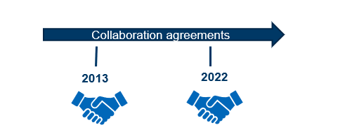
Moving Forward Together- Background
Shared goal: Improve health and better care through standardized terminology
Support enhanced clinical system functionality and interoperability by establishing principled relationships between SNOMED CT and LOINC
Provide effective support for providers and users who implement different combinations of SNOMED CT and LOINC in health information systems
Notes:
[Marjorie]
To begin with some background,
it is important to know that our organizations
Regenstrief and SNOMED International,
have been committed to working together for quite some time
to improve health and better care
through the application and use of standardized terminologies.
We established a collaboration agreement in 2013 and then revised and renewed that agreement in 2022 which speaks to our commitment for working together.
And more specifically, our goals for collaboration,
are to support enhanced clinical system functionality
and effective interoperability
by establishing principled relationships between
LOINC and SNOMED CT.
And also, we want to provide effective support for providers and users who implement different combinations of LOINC and SNOMED CT in their health information systems.

Slide 73
The LOINC Ontology: A LOINC and SNOMED CT Interoperability Solution
Extension of SNOMED CT
SNOMED CT: ontological framework
LOINC: content
Distribute LOINC content to LOINC and SNOMED CT users
Create SNOMED CT and LOINC codes for all concepts that are shared between the terminologies
Easy for implementers to have a unified approach to implementing both standards, giving them a choice of which codes to use for ease of implementation
Provide a single solution that meets clinical and regulatory requirements, globally
Notes:
And, what we have been working on together is
The LOINC Ontology:
which is A LOINC and SNOMED CT Interoperability Solution
Its actually a LOINC extension of SNOMED CT where SNOMED CT provides
the ontological framework
and LOINC provides the content.
and it offers the ability to distribute LOINC content
to both LOINC and SNOMED CT users.
And that happens by creating both
SNOMED CT and LOINC codes
for all concepts that are shared between the terminologies.
The LOINC Ontology makes it easier for implementers to have a unified approach for implementing each standard
and it offers a choice to select codes based on clinical or regulatory requirements

Slide 74
The LOINC Ontology: A LOINC and SNOMED CT Interoperability Solution
Benefits
Provides LOINC pathology and lab content in an understood format to countries who do not currently use LOINC
Provides the ontological framework for LOINC to meet the needs of the community for a computable representation of LOINC
Leverage LOINC and SCT subject matter expertise
Sets a precedent for other domains and standard collaborations
Notes:
There are a number of benefits that the extension offers including:
Providing pathology and laboratory content from LOINC
in an understood format
to countries that do not currently use LOINC.
And as such, offers the potential for broader adoption.
It provides an ontological representation of LOINC in response to the needs and requests of the community.
Our collaboration leverages
LOINC and SNOMED CT subject matter expertise
ensuring that the interoperability solution is authoritative.
And our collaboration also sets a precedent for other domains and standard collaborations.
And with that,
I will turn the floor over to Stan Huff.

Slide 75
Progress to date and other information
Preview released mid October
≈23K-24K Laboratory LOINC
Created a user site: loincsnomed.org
Browser: browser.loincsnomed.org
Meetings:
Salt Lake City, Montreal, London
bi-monthly project team meetings
Owned & maintained by Regenstrief, including responsibility for the model (concept model as well as the ontology)
Notes:
Earlier this week we released a preview of the extension,
It has somewhere between 23 and 24,0000 concepts from laboratory LOINC

Slide 76
More information
All LOINC content will eventually be in the extension
We will map existing SNOMED observables to LOINC codes and make new LOINC codes as needed
We will map/match LOINC parts to SNOMED concepts, and create new SNOMED concepts as needed
We will incrementally add domains of information (lab, clinical, documents, radiology, survey instruments)
We are not creating grouper codes (we will use ECL instead)
To support exchange of data between systems that use LOINC and systems that use SNOMED CT we have provided a simple translation/equivalence table
FSNs in the LOINC Extension will be created by the rules for FSNs in the International Edition

Slide 77
Q09 - TESTS FOR COVID-19 ACTIVE DISEASE
Constraints
Observable entity
Substance(s) [RNA or Antigen]
ECL query
(<< 363787002 |Observable entity (observable entity)| : 246093002 |Component (attribute)| = << 1240411000000107 |Ribonucleic acid of severe acute respiratory syndrome coronavirus 2 (substance)|)
OR
(<< 363787002 |Observable entity (observable entity)| : 246093002 |Component (attribute)| = << 840536004 |Antigen of severe acute respiratory syndrome coronavirus 2 (substance)|)
Results (11 concepts)
Examples
Follow-along Activity
Measurement of severe acute respiratory syndrome coronavirus 2 antigen (observable entity) | Measurement of SARS-CoV-2 antigen
SARS-CoV-2 (COVID-19) RNA [Presence] in Nasopharynx by NAA with nonprobe detection (LOINC:94565-9) | SARS-CoV-2 (COVID-19) RNA [Presence] in Nasopharynx by NAA with nonprobe detection

Slide 78
Q10 – ALL TECHNIQUES THAT ARE PRE- COORDINATED WITH LAB OBSERVABLE
Constraints
Clinical laboratory observable
Technique [EXISTS]
ECL query
<< 6060001000004106 |Clinical laboratory observable (observable entity)| . << 246501002 |Technique (attribute)|
Results (160 concepts)
Examples
Follow-along Activity
Nucleic acid amplification with probe detection technique (qualifier value)
Unfractionated measurement technique (qualifier value)
Direct antiglobulin test technique (qualifier value)
Dilute Russell viper venom reduced phospholipid technique (qualifier value)

